Slide 1

Batch – MIP-ML-12
Fastag Fraud
Detection System
Presented by: Zafar Abdugafforov

Slide 2


Introduction
Fastag is an electronic toll collection system in India, implemented to make toll payments directly from a prepaid account linked to it.
Fraudulent transactions can lead to signiﬁcant ﬁnancial losses and compromise the integrity of the toll collection system.
The purpose of this project is to develop a
robust model that can accurately identify instances of fraudulent activity in Fastag transactions, ensuring security and integrity. The objectives are to explore the dataset, engineer relevant features, develop and evaluate machine learning models, and analyze the feasibility of real-time fraud detection.

Slide 3


Problem Statement
With the increasing adoption of Fastag, the need for an effective fraud detection system is paramount.
We aim to detect fraudulent transactions by analyzing key features such as transaction details, vehicle information, geographical location, and transaction amounts.
Our goals are to identify fraudulent transactions accurately and ensure the integrity and security of digital toll transactions.

Slide 4














Objectives

Slide 5
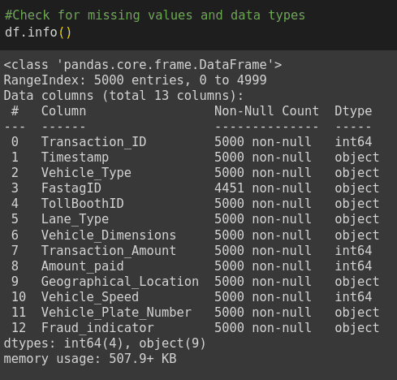
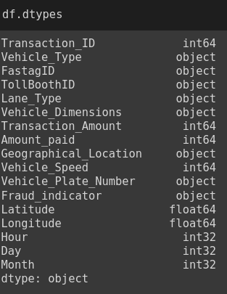
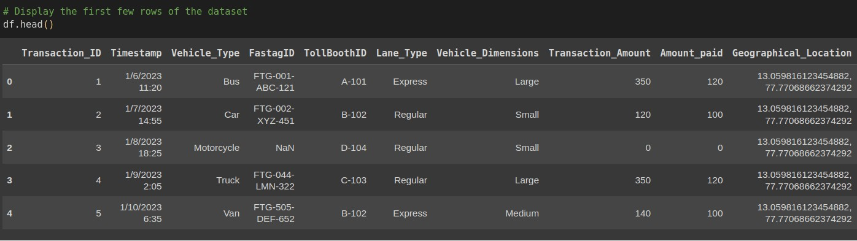
Insights:

Slide 6
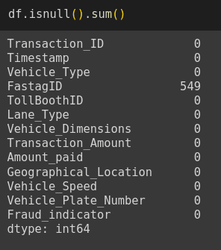
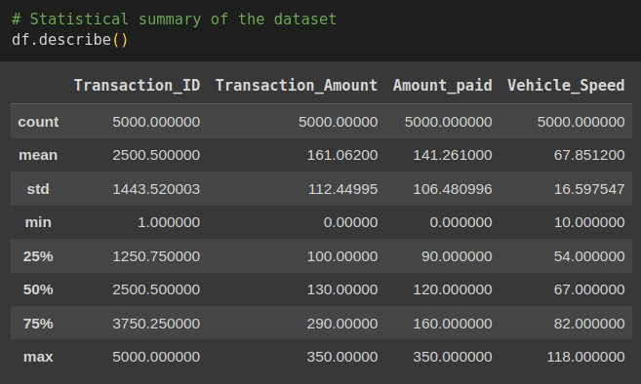
Insights:

Slide 7
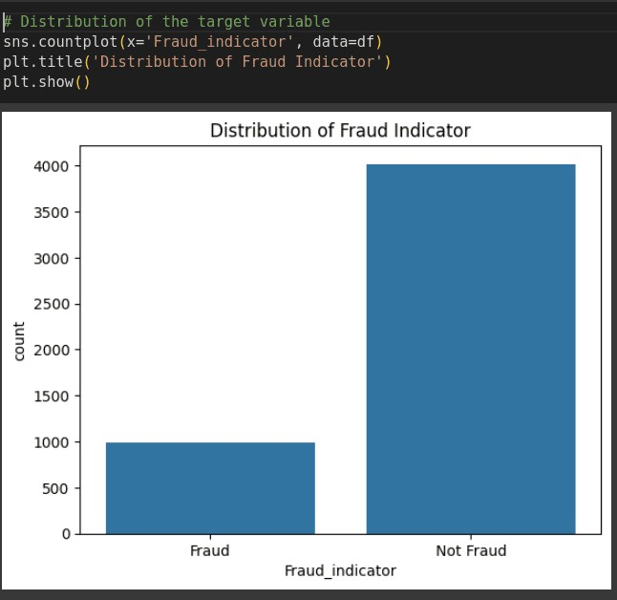
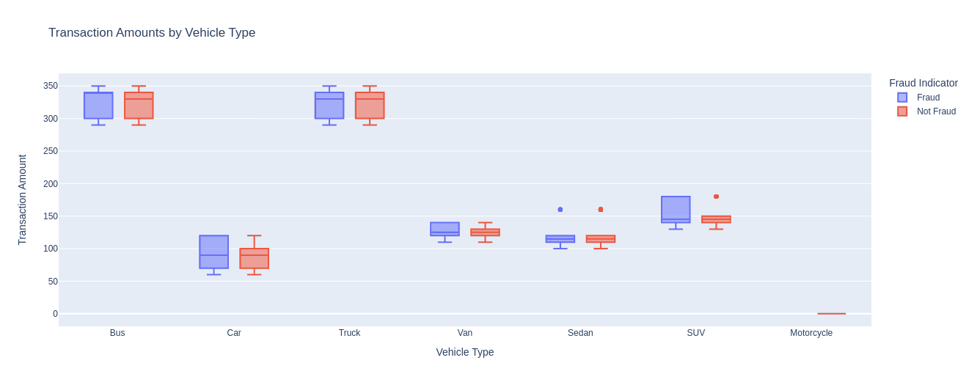
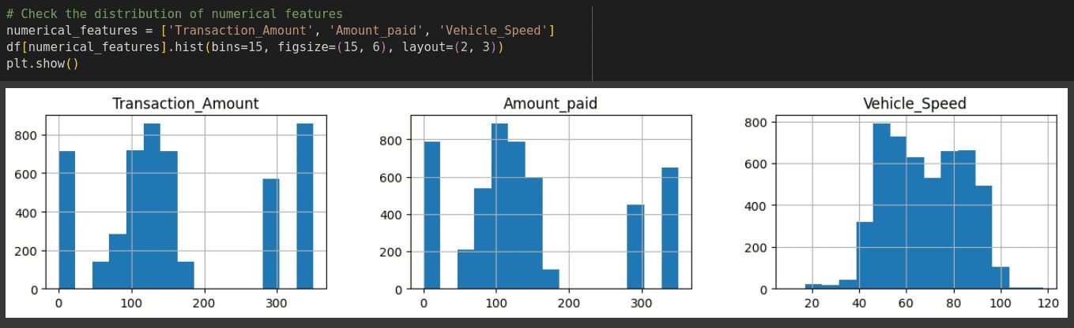
Insights:

Slide 8

Feature Engineering
Feature engineering involves creating new features from the existing data to improve model performance.
We identiﬁed and created relevant features such as:Aggregated transaction amounts for each FastagID.
Vehicle speed and dimensions
analysis.
Geographical patterns of transactions. Handling missing values and outliers was essential to ensure data quality.
Scaling and normalization of data were performed to prepare it for model training.

Slide 9
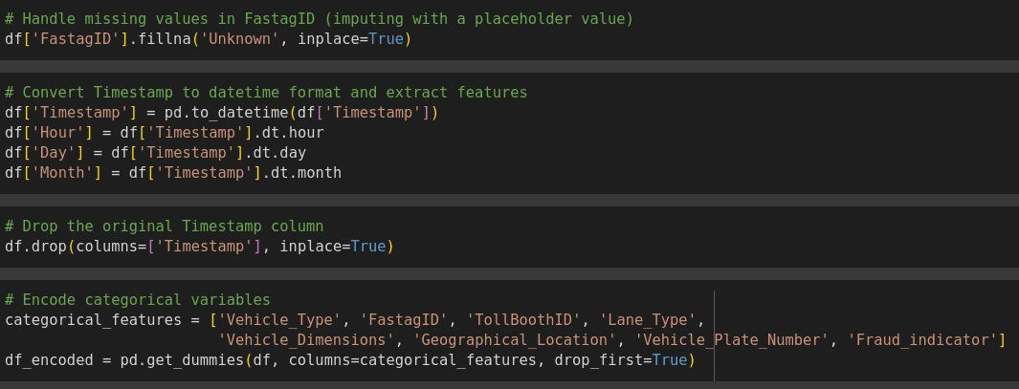
Feature Engineering

Slide 10


Model Deployment
We developed multiple machine learning models to predict and detect fraudulent transactions.
The models used include: Decision Tree Classiﬁer
Gaussian Naive Bayes Classiﬁer K-Nearest Neighbors Classiﬁer Random Forest Classiﬁer Logistic Regression
Gradient Boosting Classiﬁer
The models were trained on the training dataset and evaluated on the test dataset.

Slide 11
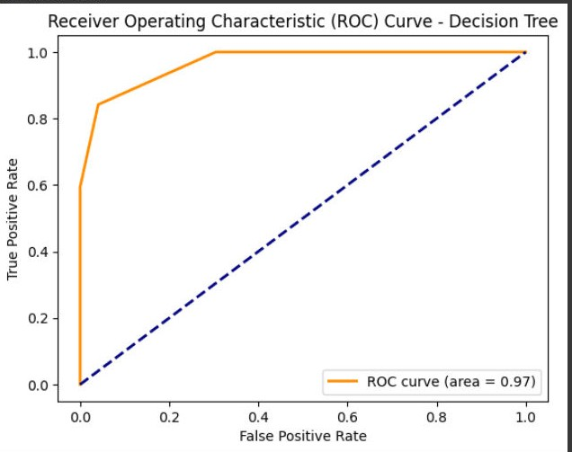
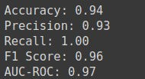
Decision Tree

Slide 12
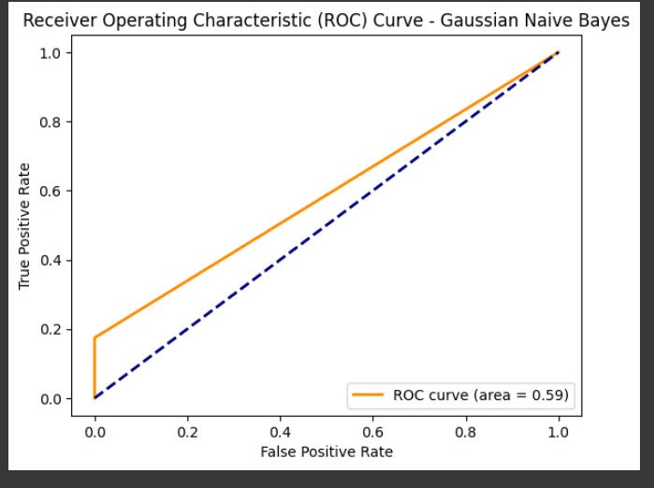
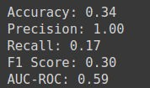
Gaussian Naive Bayes

Slide 13
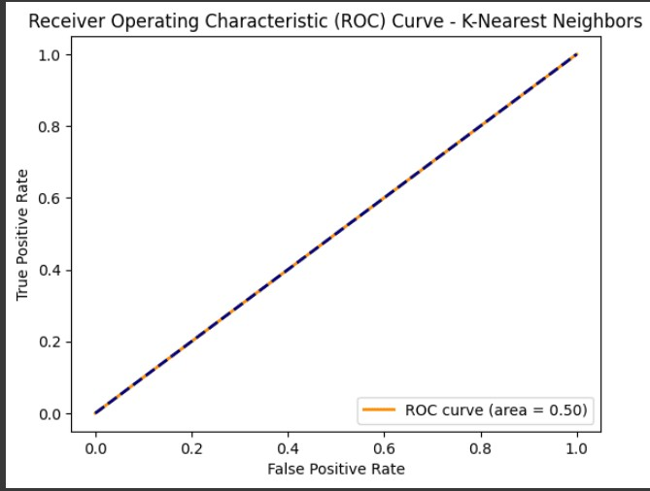
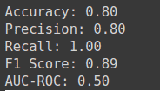
K-Nearest Neighbours

Slide 14
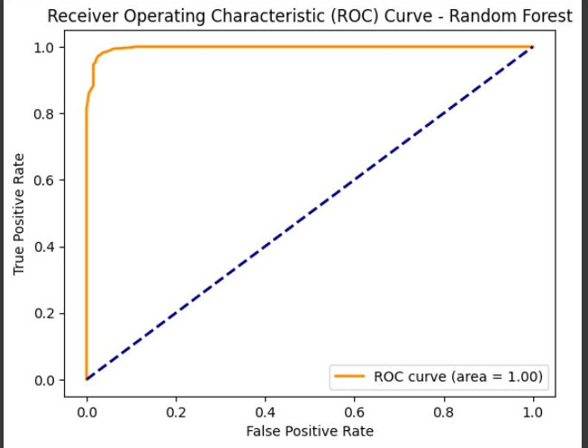
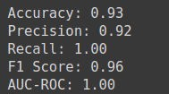
Random Forest

Slide 15
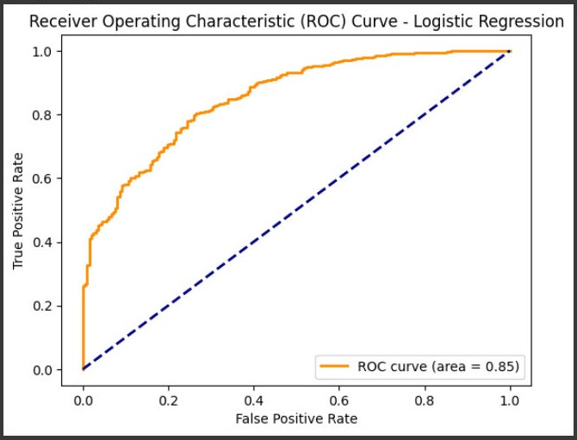
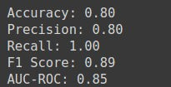
Logistic Regression

Slide 16
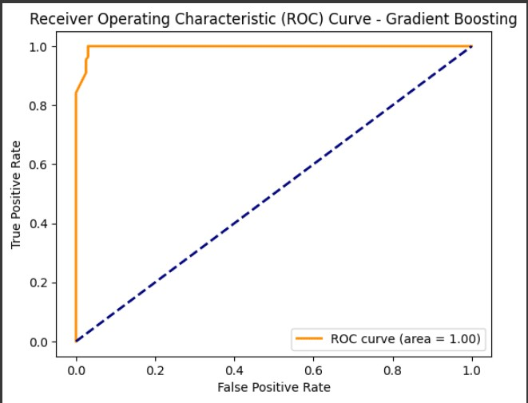
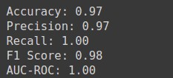
Gradient Boosting

Slide 17

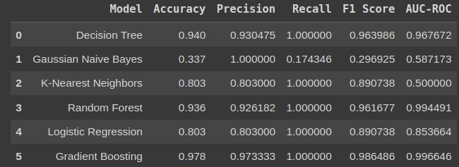
Final Results
The Gradient Boosting classiﬁer outperformed all other models with the highest accuracy, precision, recall, and F1 score. It achieved a perfect AUC-ROC score, indicating its superior ability to differentiate between fraudulent and non- fraudulent transactions.

Slide 18

Conclusion
Among the models evaluated, the Gradient Boosting Classiﬁer performed the best overall, with the highest scores across all metrics. The Decision Tree and Random Forest classiﬁers also performed very well, with high accuracy, precision, recall, and F1 scores, making them reliable choices for fraud detection. In contrast, the Gaussian Naive Bayes classiﬁer showed the poorest performance, indicating it is not well-suited for this speciﬁc task. Based on these results, the Gradient Boosting Classiﬁer is recommended for deployment in a real-time Fastag fraud detection system due to its exceptional performance and reliability.

Slide 19
Thanks!
Do you have any questions? zafarabdugaffarov@gmail.com

